Slide 1

Reinforcement Learning: Catan Bot
Ryan McGuinness
Advanced Machine Learning
Notes:
Project is in reinforcement learning, where I made a bot to play the board game Catan
This presentation will cover more general aspects of RL and some specifics of Deep Q-Networks

Slide 2
What is Reinforcement Learning
Supervised learning: learner model uses training data including the expected outputs to map inputs to certain labeled outputs
Unsupervised learning: learner model is presented with input data and is tasked with making some sense out of the data
Reinforcement learning: learner model is thrown into an environment and seeks to maximize rewards
FAQ: “Ryan, where did you find your training data?”
Notes:
We are pretty good with supervised learning
We are decent with unsupervised learning
RL fits neither category well: the agent is put directly into an environment (Catan in this case) and makes its own decisions to maximize the rewards it receives
Common question: --- There is no data. We put the model straight into the environment and it will learn on its own which actions are beneficial

Slide 3
Reward, Value Functions, and Policy
Reward is immediate feedback the learning agent receives (or doesn’t receive) after making a decision.
The long-term objective of reinforcement learning is to maximize the reward it accumulates over time. This objective is the Value Function. This does not mean to greedily maximize reward now!
Policy is the “strategy” that the learning agent adopts to maximize its value function. Policy maps the state of the environment to an action the learner can take.
Notes:
Now we discuss aspects common to all RLers
Reward is immediate feedback the agent gets directly after taking action that was beneficial
But we want the agent to maximize rewards over time, which might mean forgoing actions with immediate reward to gain better prospects of being rewarded in future.. This is the Value Function – the objective function
The policy is how the agent maps the “observation” (state of the environment) to the action – in a board game, this is strategy

Slide 4
Q-Learning Process
1. Initialize Q-table
2. Read current state
3. Choose action based on policy
4. Perform action
5. Observe reward and new state
6. Update Q-table with new Q-value
7. Update the state and repeat 2-7
Notes:
One of the most common RL agents is the Q-learner, and here is its process:
First step initialize the Q-table, what does that mean?

Slide 5
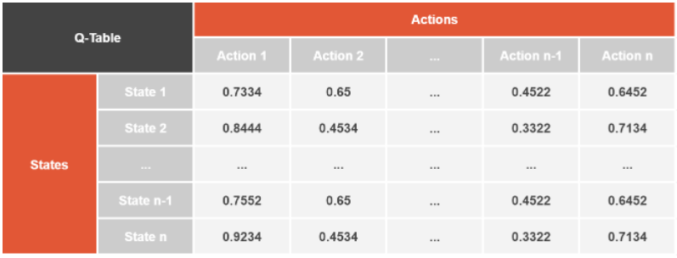
Example Q-Table
Notes:
Well, here is an example Q-table – each row corresponds to an observed state and each column corresponds to an action, and we have a value for each state-action pair

Slide 6
Q-Value and Q-Tables
A Q-Value is a predictive measure of long-term reward accumulation for a learning model with a specific policy in a specific state.
Q-values are stored in a Q-Table, with dimensions of the number of allowable actions and the number of allowable states of the environment. The table is initialized to all zeros at the beginning of the learning process.
Notes:
These values are Q-Values: They are predictive measures of how much reward an action is likely to earn in the long term
Q is not exactly equal to this value, but it is highly correlated: higher Q value means higher prospect of reward
Then the Q-table consists of Q-values for every state-action pair. At the beginning of the training process, table is initialized to zeros

Slide 7
Q-Learning Process
1. Initialize Q-table
2. Read current state
3. Choose action based on policy
4. Perform action
5. Observe reward and new state
6. Update Q-table with new Q-value
7. Update the state and repeat 2-7
Notes:
The next three steps I will group together, where we observe the current state of the environment and select and perform an action

Slide 8
Action Selection
The model usually makes its decision on an action to take given a state by selecting the action with highest Q-value.
However, this may lead to repeating initial decisions which might not by optimal, so there is a chance the model will select a different action. This introduces a parameter ε: sample a random number, and if it is less than ε then a random action will be selected, otherwise the action with maximum Q-value is chosen (ε may decrease over time).
Notes:
How do we select an action? Actions are selected by the policy and Q-learners’ policy is simple: select action with highest Q value. So, do we always follow the policy?
This creates a problem, if we select an action with reward, everything else is 0 in the Q-table, so we will just select the same action over and over even if it might be suboptimal
So instead, we introduce hyperparameter epsilon, the chance of taking a random action regardless of the state. In practice, eps decreases over time

Slide 9
Q-Learning Process
1. Initialize Q-table
2. Read current state
3. Choose action based on policy
4. Perform action
5. Observe new state and reward
6. Update Q-table with new Q-value
7. Update the state and repeat 2-7
Notes:
Then we observe the new state and reward, and use that info to update the Q-table

Slide 10
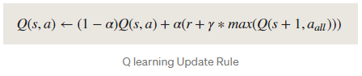
Updating Q-Value
The Q-value for the state and action taken is updated according to the reward and a couple parameters.
Learning rate α controls how fast the model learns.
Discount factor γ sets the value of future rewards relative to present rewards, if the same action were to be taken in the next state. Without this, the updated Q-value might not converge.
Notes:
Of course, we have a couple more hyperparameters for calculating the new q-value
First, we have learning rate alpha. I won’t waste your time with this.
Second, is the discount factor gamma. Remember VF is to max rewards over time, so Q value must be a measure of a future rewards. But if we calculate *all* rewards, then we might have a problem where Q diverges. So the discount factor gamma < 1 is multiplied by the expected future rewards to deal with this. But doing this does mean immediate rewards are more valuable than future rewards
And here is the math of updating the Q value, I promise its not as bad as it looks. It is a weighted average of the current Q value and this part, the rewards received and the maximum q value in the next state, weights determined by alpha

Slide 11
Q-Learning Process
1. Initialize Q-table
2. Read current state
3. Choose action based on policy
4. Perform action
5. Observe reward and new state
6. Update Q-table with new Q-value
7. Update the state and repeat 2-7
Notes:
Then this process is repeated for as long as we train the agent
But we have a problem: first our observation space is very large. Second:

Slide 12
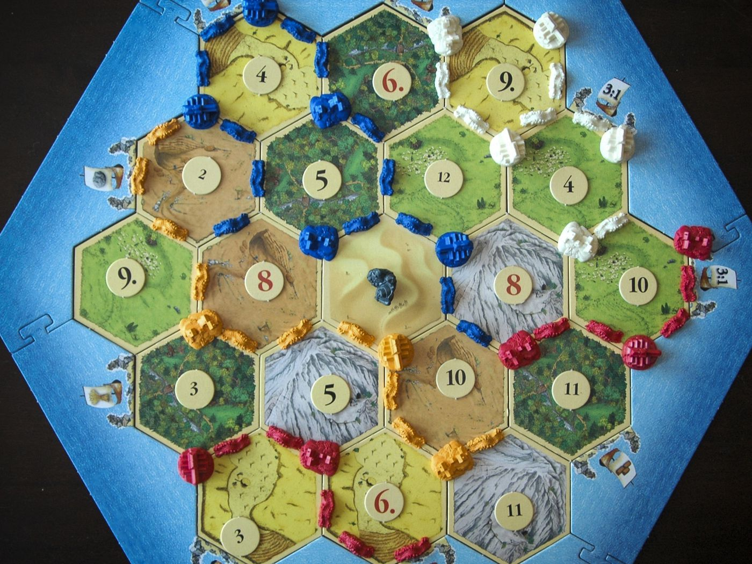
Notes:
Those of you familiar with the game of Catan know that in order to accurately capture the state of the game, you need to describe every vertex (whether it is occupied by a settlement or city, and what color), every edge (whether it is occupied by a road, and what color), the location of the robber, the cards in one’s hand, the cards one has already played, and if you are playing with random board setups, the types of terrain at every hex and the number on each hex, and the location of all the ports. This is a lot of information to capture. Our second problem is:

Slide 13
DQN: Deep Q-Networks
Now, if none of this sounded quite like deep learning to you, you’d be correct.
DQNs layer a neural network over a Q-learner in order to handle higher dimensional data. The neural network will predict the Q-values for all actions in an observed state.
Advantage: will handle unfamiliar states better than simple Q-learning
Disadvantage: will take much longer to train
Notes:
This is a deep learning class, and we have not talked about DL yet. Fortunately, the solution to both problems are the same.
DQNs which utilizes a NN to predict Q-values associated with all actions in a state, and policy is to select action with maximum predicted Q-value. This is regression: The optimal action isn’t being predicted, the Q values are
One major advantage: Q-Learners have no idea what to do in an unfamiliar state because the Q-table is initialized to zeros and q-values are only updated for states it’s been in and actions it has played. DQN will predict the Q-values using q-values from familiar states
One major disadvantage: as with all DLers, it takes a long time to train

Slide 14
Implementation in Python: gym
The gym package from OpenAI is used to create environments.
Environments subclassing gym.Env must include methods __init__, reset, step, and render.
__init__ must define an action space and an observation space
reset is called when initializing the environment and whenever the environment should be reset to its initial conditions
step is called whenever we need to model to take an action. This method also observes the next state and calculates the reward of the action it has just taken.
render is used to render the environment to the screen.
Notes:
Now I’ll spend a little time on implementation:
Environments are created using the package gym from OpenAI
In order to create an environment, you need to specify these four methods.
Important to define the action space and observation space in __init__
Reset will set env to initial conditions (start of game)
Step is used to observe the state, perform action, and calculate the reward
Render is used to render the environment to the screen. Not actually required to write any code, but you have to define the method.

Slide 15
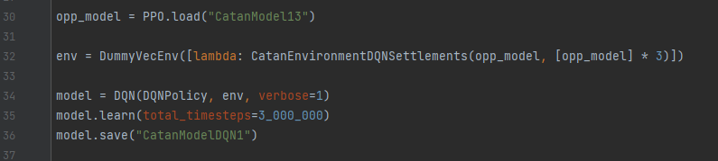
Implementation in Python: stable-baselines3
The stable-baselines3 package, based on baselines by OpenAI, is used to create the RL agents.
An agent needs a policy optimizer and an environment in its definition
Notes:
And agents are created with stable-baselines3, based on baselines by OpenAI
Agents just need policy optimize and environment, and that’s it.
If you don’t believe me, where is the section of code where I define and train an agent.

